Slide 1
ACTIVITY DIAGRAM

Slide 2
ACTIVITY DIAGRAM
Activity Diagram describe the dynamic aspects of the system
Activity Diagram is basically a flowchart to represent the flow from one activity to another activity
Activity Diagram is closely related to use case diagram
We use Activity Diagrams to illustrate the flow of control in a system and refer to the steps involved in the execution of a use case.
An activity diagram portrays the control flow from a start point to a finish point showing the various decision paths that exist while the activity is being executed.
In simple: Activity Diagram shows ‘HOW’ while a use case shows ‘What’ for particular system

Slide 3

Activity Diagram Notations –
Initial State – The starting state before an activity takes place is depicted using the initial state.
Figure – notation for initial state or start state

Slide 4

Activity Diagram Notations –
Action or Activity State – An activity represents execution of an action on objects or by objects. We represent an activity using a rectangle with rounded corners. Basically any action or event that takes place is represented using an activity

Slide 5
Activity Diagram Notations
Action Flow or Control flows – Action flows or Control flows are also referred to as paths and edges. They are used to show the transition from one activity state to another.

Slide 6
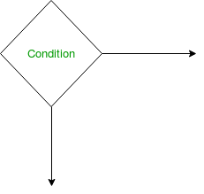
Activity Diagram Notations
Decision node and Branching – When we need to make a decision before deciding the flow of control, we use the decision node.

Slide 7
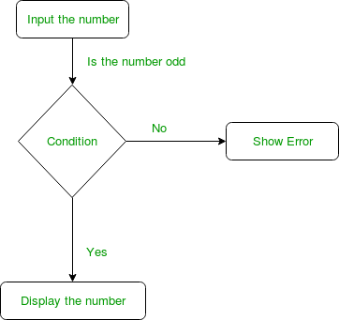
Example:

Slide 8
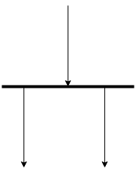
Activity Diagram Notations
Fork – Fork nodes are used to support concurrent activities
When we use a fork node when both the activities get executed concurrently

Slide 9
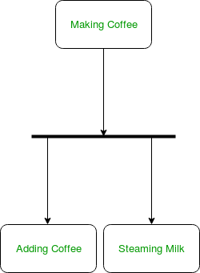
Example:

Slide 10
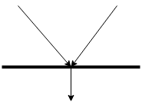
Activity Diagram Notations
join – Join nodes are used to support concurrent activities converging into one. For join notations we have two or more incoming edges and one outgoing edge.

Slide 11
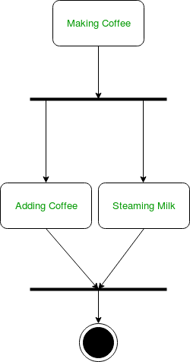
Example:

Slide 12
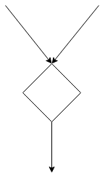
Activity Diagram Notations
Merge or Merge Event – Scenarios arise when activities which are not being executed concurrently have to be merged. We use the merge notation for such scenarios. We can merge two or more activities into one if the control proceeds onto the next activity irrespective of the path chosen.

Slide 13
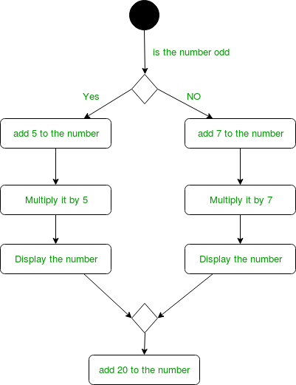
Example:

Slide 14
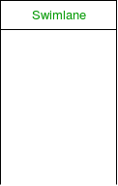
Swimlanes – We use swimlanes for grouping related activities in one column. Swimlanes group related activities into one column or one row. Swimlanes can be vertical and horizontal. Swimlanes are used to add modularity to the activity diagram. It is not mandatory to use swimlanes. They usually give more clarity to the activity diagram. It’s similar to creating a function in a program. It’s not mandatory to do so, but, it is a recommended practice.

Slide 15
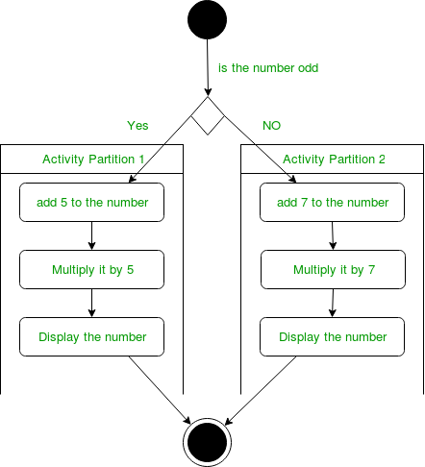
Example:

Slide 16

Activity Diagram Notations
Time Event: We can have a scenario where an event takes some time to complete. We use an hourglass to represent a time event.

Slide 17
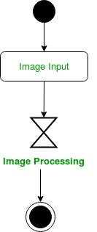
Example:

Slide 18

Activity Diagram Notations
Final State or End State – The state which the system reaches when a particular process or activity ends is known as a Final State or End State. We use a filled circle within a circle notation to represent the final state in a state machine diagram. A system or a process can have multiple final states.

